Slide 1
Cell Phone Detector using Op - Amp
G. Lakshmi Aishwarya - 180040131
N. Satish - 180040132
N. Alekya - 180040137
Ch. Sri Charan - 180040140

Slide 2
Abstract:-
In this modern world, the technology increases day by day electronic components with wide range of features and becoming minute in size.
As the usage of electronic components increases, there is a misuse of electronic components by using them in confidential rooms and some restricted areas.

Slide 3
To get rid of these situations , cell phone detector is the equipment used to detect .
This mobile detector circuit detect incoming/outgoing calls, messaging ,video transmission and any SMS or GPRS uses within the range of one meter.

Slide 4
Objective:-
Detects the presence of electromagnetic waves.
As, Cell phones use electromagnetic waves to communicate

Slide 5
Overview:-
The cell phone detector when is present near activated mobile phone receives radio frequency signal.
This radio frequency signal is fed into Op-Amp through capacitor.
The minute current change produced through rf signals is converted into finite voltage to glow led and activate buzzer.
This is done by op-amp with the help of transistor.
If the mobile is not activated the there is no rf signals and hence led and buzzer will be in off state.

Slide 6
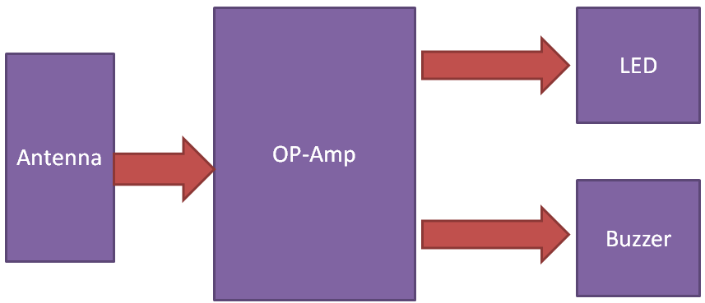
Block Diagram:-

Slide 7
DetectedThrough
Minute current converted to
Led blinks randomly and buzzer is activated
Radio Frequency Signals
Operational
Amplifier
capacitor
Appreciable voltage
Not detected
Led and buzzer will be deactivated
Working of cellphone detector through flow chart

Slide 8
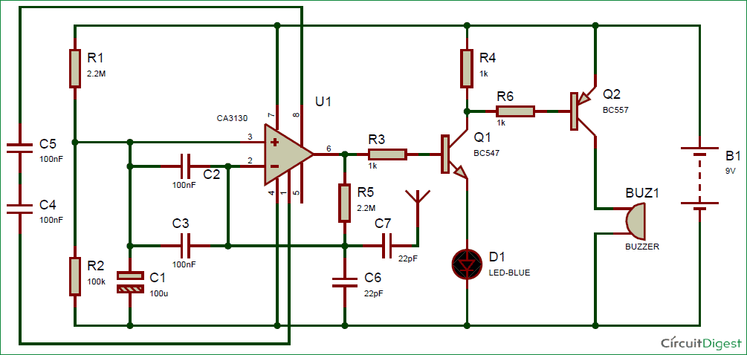
Circuit Diagram:-

Slide 9
Methodology:-
OP-AMP IC is used for detecting incoming or outgoing signal around it
Its inverting terminal is feedback from its output to amplify the signal.
Output of this op-amp is connected at the base of NPN transistor , BC547 , and an LED is connected at its emitter for indication
A buzzer is also used for sound indication

Slide 10
Applications:-
To identify and restrict electronic gadgets ie.,mobile phones in confidential places
Detect incoming and outgoing calls, messaging ,video transmission and any SMS within the range of 1 meter.

Slide 11
Conclusion:-
This pocket-size mobile transmission detector or sniffer can sense the presence of an activated mobile cell phone from a distance of one meter.
So it can be used to prevent use of mobile phone for spying and unauthorized video transmission.

